Slide 1

Interim Review Presentation
SocialPulse-Social Media Engagement Analyser and Strategy Assistant
Team Members:
Aleeta K Alex(19)
Archana R(32)
Arya Vinod(34)
Devika Girish(49)|
Internal Guide :Er. Jinu Thomas
Department of Computer Science and Engineering
LEARN . GROW . EXCEL

Slide 2
Problem Statement & Domain
The Problem
Data Overload: Social platforms generate massive amounts of raw data (likes, timestamps) that is often "noisy" and fragmented.
Manual Analysis Struggle: It is nearly impossible for creators to manually correlate factors—like posting time—with audience interaction.
The "Insight Gap": There is a lack of transparent, rule-based tools to transform raw numbers into clear, actionable visuals.
Result: Without these insights, creators are unable to spot patterns or make data-driven decisions to grow.
The Domain
Data Analytics (Processing raw engagement metrics)
Information Visualization (Converting data into charts/trends)
LEARN . GROW . EXCEL

Slide 3
Objectives
The objective of this project is to collect and analyze structured social media engagement data in order to understand how users interact with different posts.
The system calculates engagement levels using simple rule-based methods to identify high-performing posts and effective posting times.
By presenting the results through clear and easy-to-understand visual charts, the project helps users gain meaningful insights and make better decisions about their social media posting behavior.
LEARN . GROW . EXCEL

Slide 4
Proposed Methodology
Step 1: Data Input The user provides structured social media engagement data in the form of a CSV or Excel file containing post details, likes, comments, and posting time.
Step 2: Data Pre-Processing The system cleans and processes the input data to ensure it is in a usable format for analysis.
Step 3: Engagement Calculation Engagement levels for each post are calculated using simple rule-based mathematical formulas.
Step 4: Pattern Analysis Posts are grouped and analyzed based on posting time and engagement to identify trends and high-performing posts.
Step 5: Data Visualization The final results are displayed using clear visual charts and comparative views to help users easily understand engagement patterns.
LEARN . GROW . EXCEL

Slide 5
Work Completed
Literature review
Identify scope
Requirement gathering
Feasibility Study
LEARN . GROW . EXCEL

Slide 6
Literature review
Sl.No | Title | Authors & Publications | Techniques Used and Observations
1 | Instagram Analytics and Insights Platform | Meta (Instagram Official Documentation) | • Provides engagement metrics such as likes, comments, reach, and impressions. • Focuses mainly on descriptive analytics. • Does not provide clear explanations or improvement strategies for post performance.
2 | Social Media Engagement Analysis Using Data Analytics | Various Research Articles (IEEE, Springer) | • Uses engagement metrics like likes, comments, and shares to measure performance. • Mostly focuses on statistical analysis and visualization. • Limited emphasis on actionable recommendations for content creators.
3 | Content Performance Evaluation in Social Media Platforms | ResearchGate Publications | • Analyzes content performance based on interaction metrics. • Highlights importance of posting time and content type. • Does not provide automated strategy suggestions or post-level explanations.
LEARN . GROW . EXCEL

Slide 7
Sl.No | Title | Authors & Publications | Techniques Used and Observations
4. | Rule-Based Recommendation Systems | Academic Surveys on Recommendation Systems | • Uses predefined rules and conditions to generate recommendations. • Transparent and easy to understand compared to machine learning models. • Suitable for small datasets and beginner-level implementations.
5. | Hashtag performance evaluation in Instagram | ResearchGate | • Studies the impact of hashtags on reach and engagement. • Shows that irrelevant hashtags reduce effectiveness. • Existing tools do not rank hashtags based on historical performance.
LEARN . GROW . EXCEL

Slide 8
Design
System Architecture
Data Flow Diagrams
UML Diagrams
LEARN . GROW . EXCEL

Slide 9
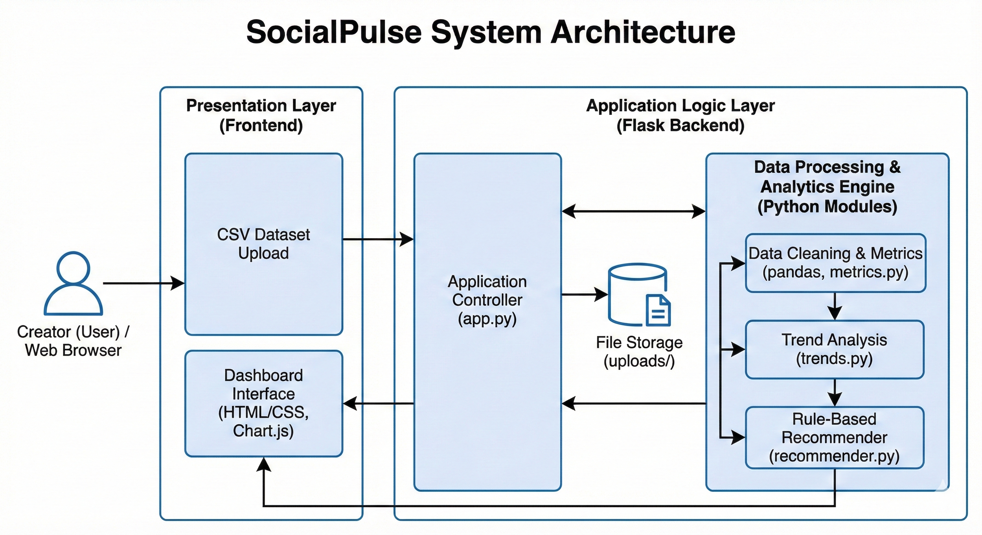
System Architecture
LEARN . GROW . EXCEL

Slide 10
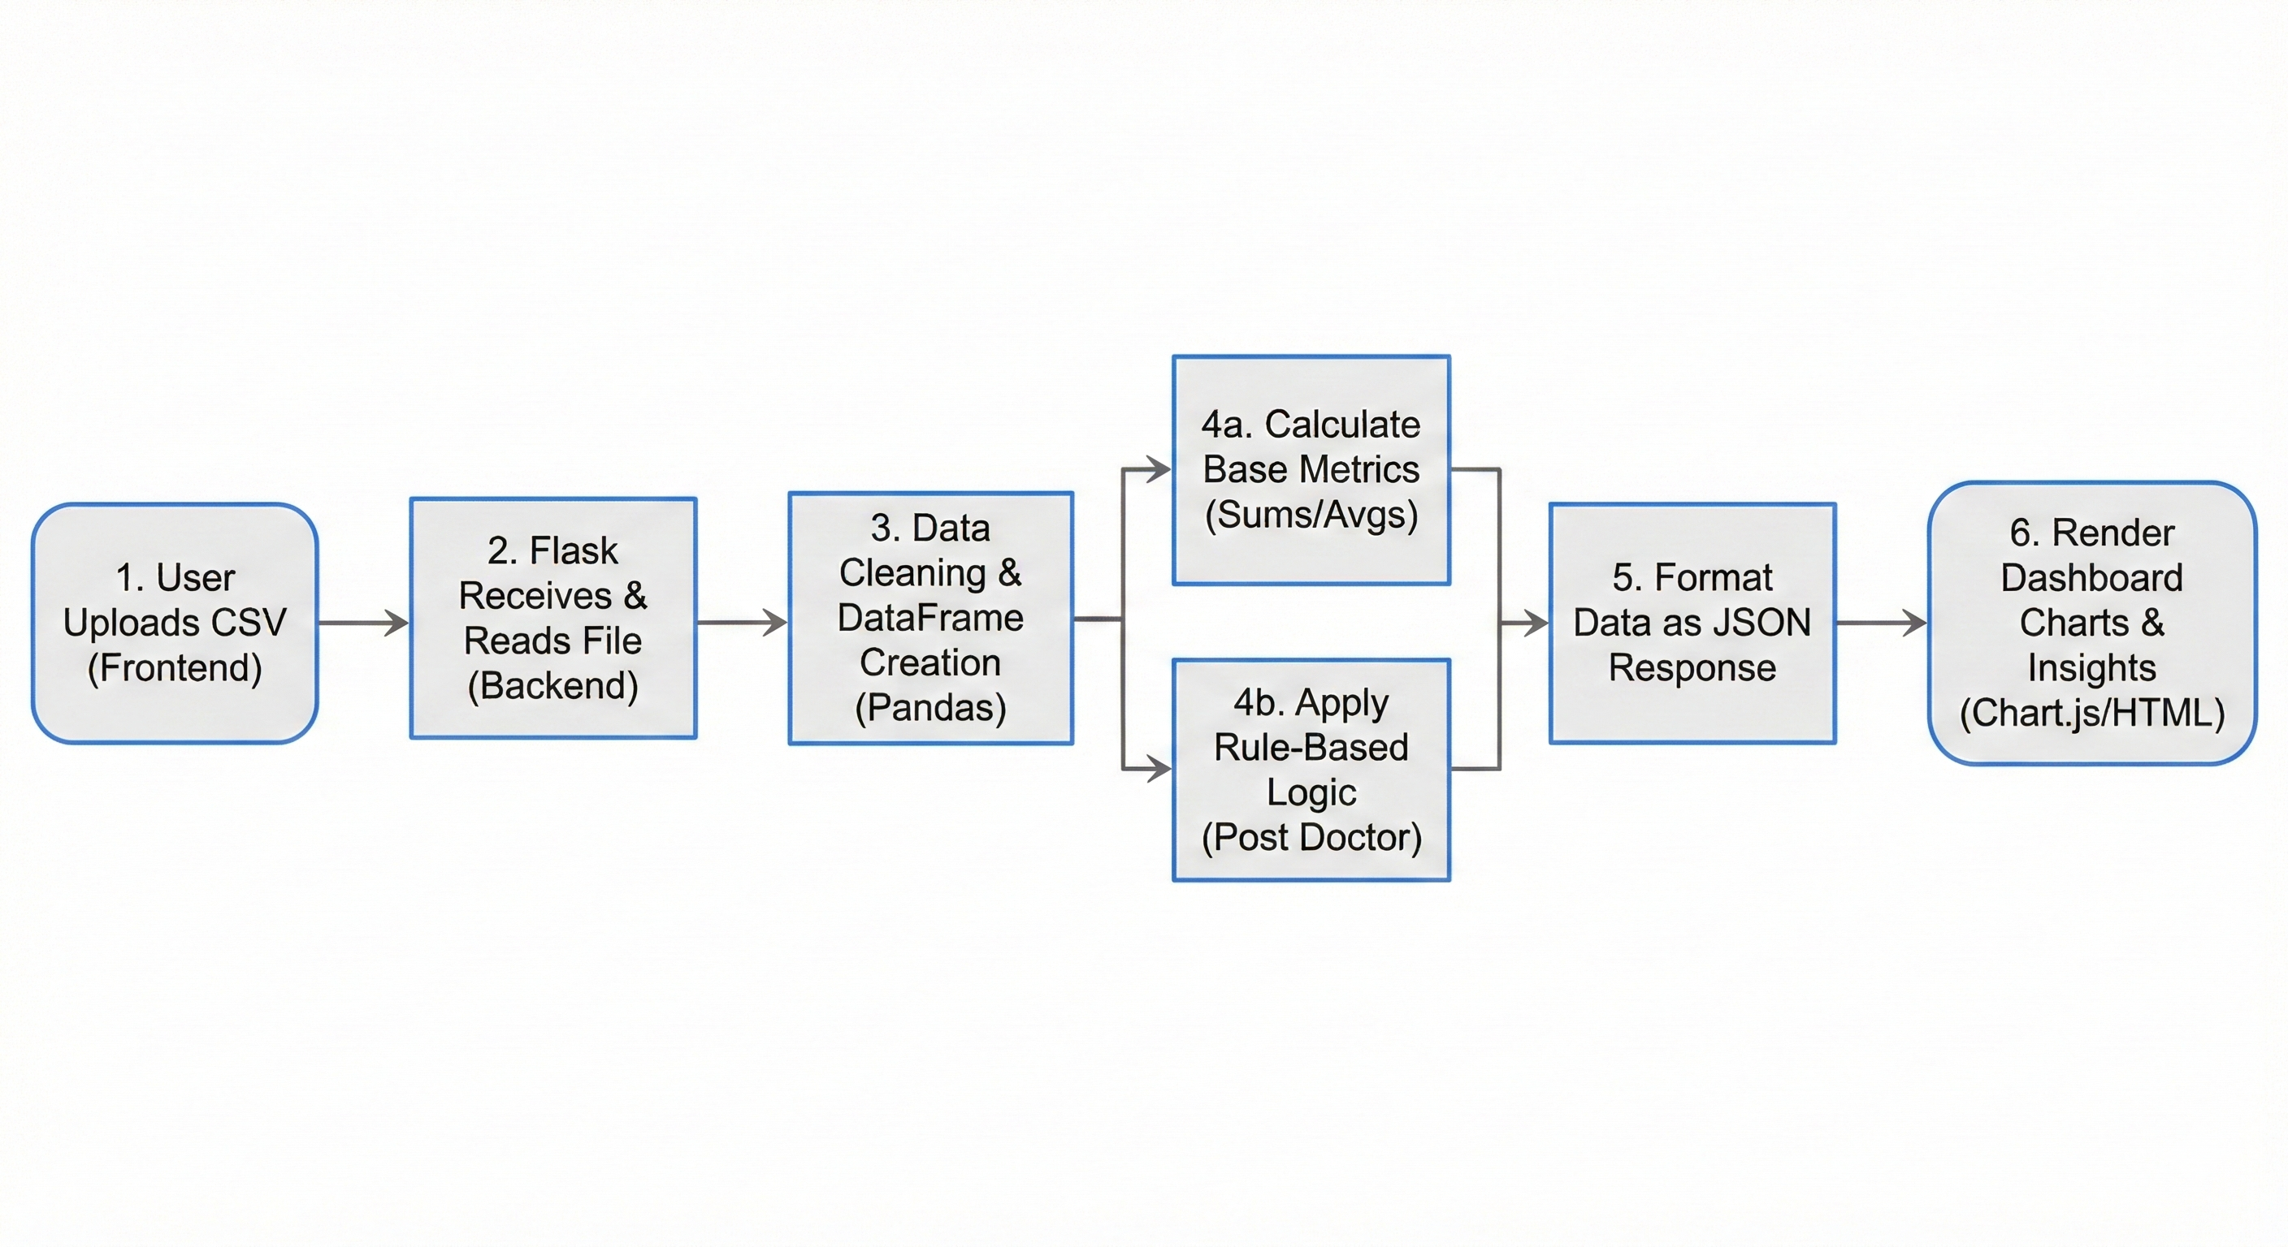
Data Flow Diagram
LEARN . GROW . EXCEL

Slide 11
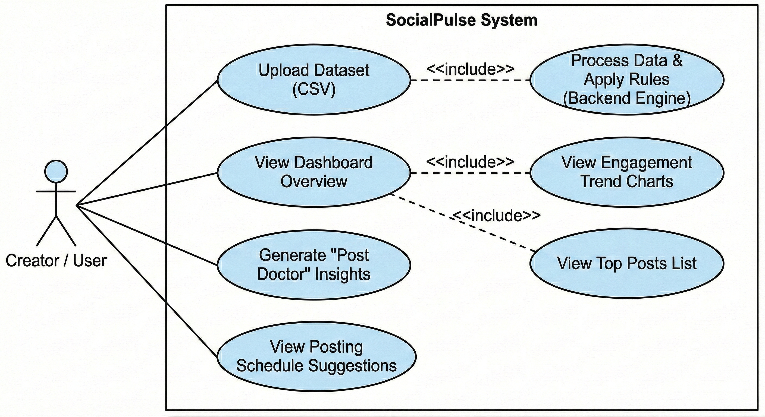
UML Diagram
LEARN . GROW . EXCEL

Slide 12
Technology Used
• Frontend: HTML, CSS, Bootstrap • Charts: Chart.js • Backend: Python Flask • Data Processing: Pandas • Dataset Format: CSV / Excel • NLP (Optional): TextBlob / VADER
LEARN . GROW . EXCEL

Slide 13
Proposed New Solution
• Convert engagement data into actionable insights • Explain why a post performed well or poorly • Suggest improvements using rule-based logic • Generate posting schedules and hashtag strategies • Detect performance drops automatically • Provide downloadable creator reports
LEARN . GROW . EXCEL

Slide 14
Gantt Chart
Week 1–3
Week 4–6
Week 7–9
Week 10–12
Literature Review &Problem
Study
System Design & Analysis
Implementation & Visualization
Testing & Documentation
LEARN . GROW . EXCEL

Slide 15
CONTRIBUTION
Frontend Development –Archana ,Arya ,Devika
Backend Development – Aleeta,Archana
Documentation – Arya,Devika,Aleeta
Github project Link - https://github.com/archana242/MINI-PROJECT.git
Github ID:
aleetakalex
devikagirish515
archana242
Arya20040110
LEARN . GROW . EXCEL

